Slide 1
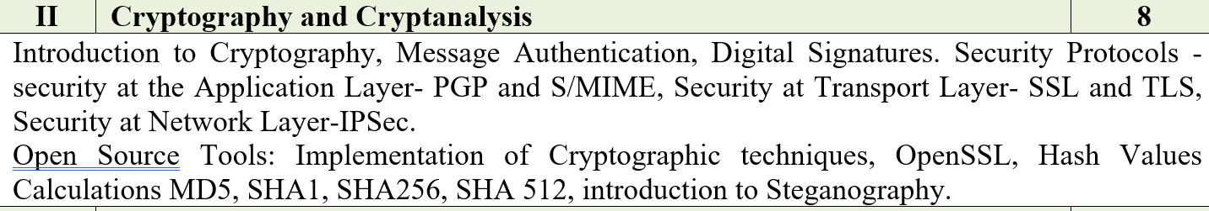
UNIT -2 CRYPTOGRAPHY AND CRYPTANALYSIS

Slide 2
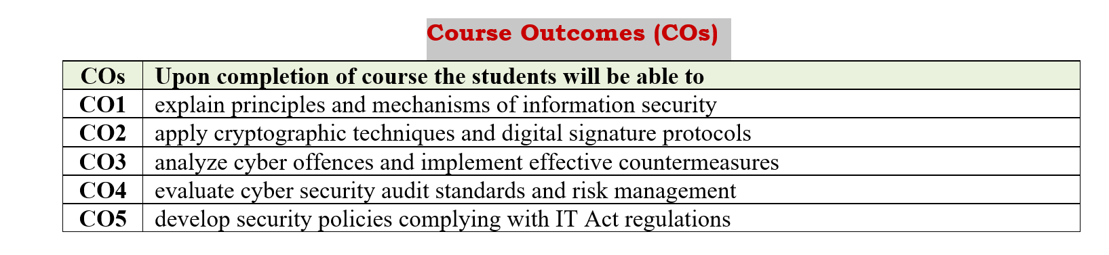

Slide 3
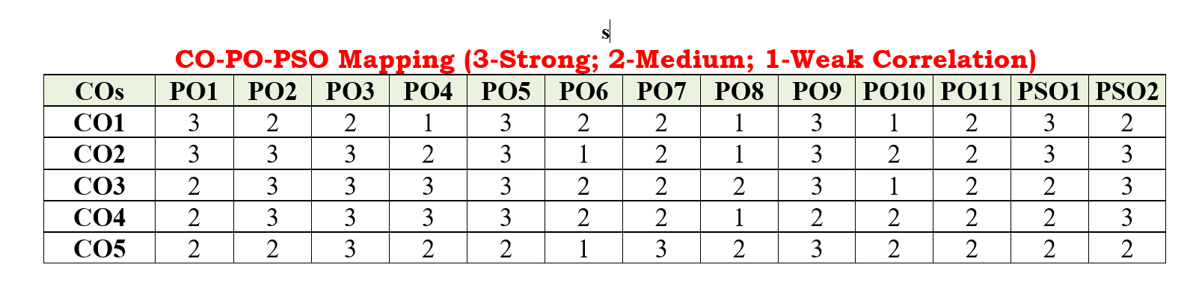

Slide 4
Introduction to Cryptography
Cryptography is a method of protecting information and communications through the use of codes, so that only those for whom the information is intended can read and process it.
Cryptography is the science of using mathematics to encrypt and decrypt data. Cryptography enables you to store sensitive information or transmit it across insecure networks (like the Internet) so that it cannot be read by anyone except the intended recipient.

Slide 5
Symmetric cryptography
Symmetric cryptography, known also as secret key cryptography, is the use of a single shared secret to share encrypted data between parties. Ciphers in this category are called symmetric because you use the same key to encrypt and to decrypt the data.
Some common symmetric key cryptography examples include the Advanced Encryption Standard (AES), the Data Encryption Standard (DES), along with IDEA, Blowfish, RC4 (Rivest Cipher 4), RC5 (Rivest Cipher 5), and RC6

Slide 6
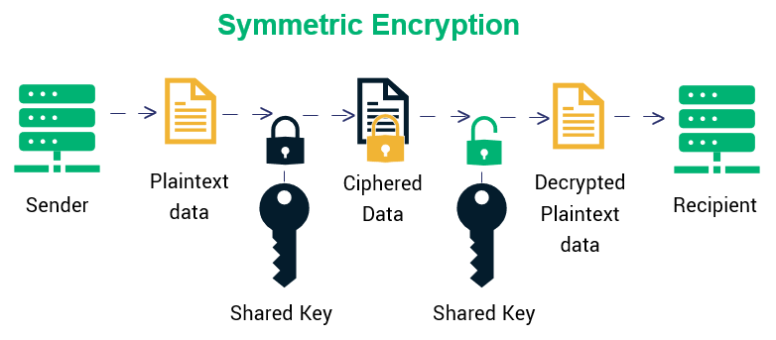

Slide 7
Asymmetric cryptography
Asymmetric cryptography, also known as public-key cryptography, is a process that uses a pair of related keys -- one public key and one private key -- to encrypt and decrypt a message and protect it from unauthorized access or use.
Examples of asymmetric encryption include: Rivest Shamir Adleman (RSA) the Digital Signature Standard (DSS), which incorporates the Digital Signature Algorithm (DSA) Elliptical Curve Cryptography (ECC)

Slide 8
Message authentication
Message authentication is another form of security. Similar to data encryption to ensure data confidentiality
Message authentication data security feature: Provides services to ensure the integrity of data for selected LU-LU sessions

Slide 9
Message Authentication Code (MAC)
MAC algorithm is a symmetric key cryptographic technique to provide message authentication. For establishing MAC process, the sender and receiver share a symmetric key K.
MAC is an encrypted checksum generated on the underlying message that is sent along with a message to ensure message authentication.
The process of using MAC for authentication is depicted in the following illustration −

Slide 10
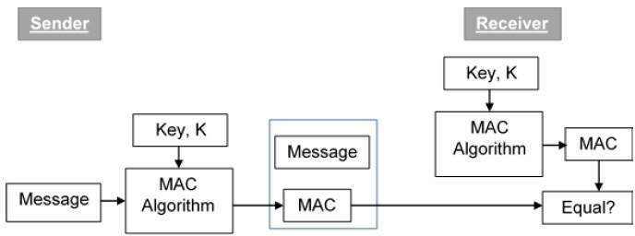
The sender uses some publicly known MAC algorithm, inputs the message and the secret key K and produces a MAC value.
Similar to hash, MAC function also compresses an random long input into a fixed length output.
The major difference between hash and MAC is that MAC uses secret key during the compression.
The sender forwards the message along with the MAC. Here, we assume that the message is sent providing message origin authentication, not confidentiality.
If confidentiality is required then the message needs encryption.

Slide 11
On receipt of the message and the MAC, the receiver feeds the received message and the shared secret key K into the MAC algorithm and re-computes the MAC value.
The receiver now checks equality of freshly computed MAC with the MAC received from the sender. If they match, then the receiver accepts the message and assures himself that the message has been sent by the intended sender.
If the computed MAC does not match the MAC sent by the sender, the receiver cannot determine whether it is the message that has been altered or it is the origin that has been falsified. As a bottom-line, a receiver safely assumes that the message is not the genuine.

Slide 12
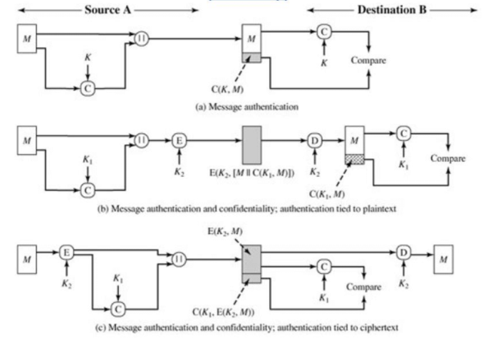

Slide 13
Digital Signatures
Digital signatures are the public-key primitives of message authentication. In the physical world, it is common to use handwritten signatures on handwritten or typed messages. They are used to bind signatory to the message.
Similarly, a digital signature is a technique that binds a person/entity to the digital data. This binding can be independently verified by receiver as well as any third party.
Digital signature is a cryptographic value that is calculated from the data and a secret key known only by the signer.
Model of Digital Signature
The digital signature scheme is based on public key cryptography. The model of digital signature scheme is depicted in the following illustration −

Slide 14
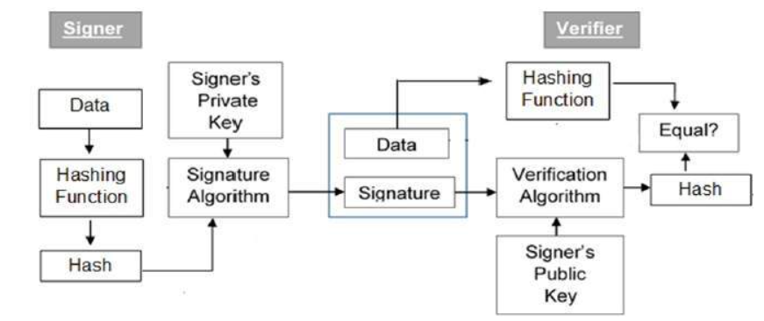

Slide 15
The following points explain the entire process in detail −
Each person adopting this scheme has a public-private key pair.
Generally, the key pairs used for encryption/decryption and signing/verifying are different. The private key used for signing is referred to as the signature key and the public key as the verification key.
Signer feeds data to the hash function and generates hash of data.
Hash value and signature key are then fed to the signature algorithm which produces the digital signature on given hash. Signature is appended to the data and then both are sent to the verifier.

Slide 16
Verifier feeds the digital signature and the verification key into the verification algorithm. The verification algorithm gives some value as output.
Verifier also runs same hash function on received data to generate hash value.
For verification, this hash value and output of verification algorithm are compared. Based on the comparison result, verifier decides whether the digital signature is valid.
Since digital signature is created by ‘private’ key of signer and no one else can have this key; the signer cannot repudiate signing the data in future.

Slide 17
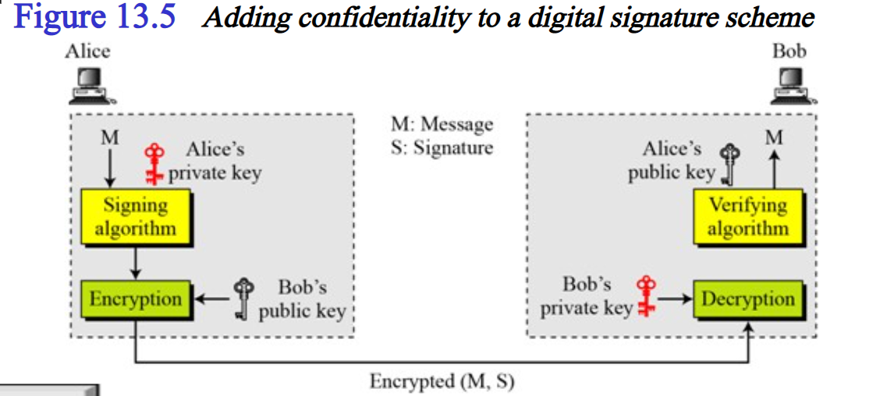

Slide 18
Importance of Digital Signature
Out of all cryptographic primitives, the digital signature using public key cryptography is considered as very important and useful tool to achieve information security.
Apart from ability to provide non-repudiation of message, the digital signature also provides message authentication and data integrity. Let us briefly see how this is achieved by the digital signature −
Message authentication − When the verifier validates the digital signature using public key of a sender, he is assured that signature has been created only by sender who possess the corresponding secret private key and no one else.

Slide 19
Data Integrity − In case an attacker has access to the data and modifies it, the digital signature verification at receiver end fails. The hash of modified data and the output provided by the verification algorithm will not match. Hence, receiver can safely deny the message assuming that data integrity has been breached.
Non-repudiation − Since it is assumed that only the signer has the knowledge of the signature key, he can only create unique signature on a given data. Thus the receiver can present data and the digital signature to a third party as evidence if any dispute arises in the future.

Slide 20
Security protocols
It is also called cryptographic protocol, it represent transferring specially constructed encrypted messages between legitimate protocol participants to fulfill objectives such as mutual authentication or key-exchange in a predefined procedure.
A security protocol is essentially a communication protocol – an agreed sequence of actions performed by two or more communicating entities in order to accomplish some mutually desirable goal – that makes use of cryptographic techniques, allowing the communicating entities to achieve a security goal.

Slide 21
Types of Security Protocols
IPSec and VPNs
SSL and TLS
Application Transparent Transport Layer Security
Kerberos
OSPF authentication
SNMPv3

Slide 22
IPSec and VPNs
It provides authentication, integrity, and data privacy between any two IP entities.
With IPSec, you can create virtual private networks (VPN). A VPN enables an enterprise to extend its private network across a public network, such as the Internet, through a secure tunnel called a security association.
IPSec VPNs enable the secure transfer of data over the public Internet for same-business and business-to-business communications, and protect sensitive data within the enterprise's internal network.

Slide 23
SSL and TLS
The SSL protocol provides data encryption, data origin authentication, and message integrity
It also provides server and client authentication using X.509 certificates.
SSL begins with a handshake during which the server is authenticated to the client using X.509 certificates.
Also, the client can optionally be authenticated to the server.
During the handshake, security session parameters, such as cryptographic algorithms, are transferred and session keys are created.
After the handshake, the data is protected during transmission with data origin authentication and optional encryption using the session keys.

Slide 24
Application Transparent Transport Layer Security (AT-TLS)
Application Transparent Transport Layer Security (AT-TLS) creates a secure session on behalf of an application.
Instead of implementing TLS in every application that requires a secure connection, AT-TLS provides encryption and decryption of data based on policy statements that are coded in the Policy Agent.
The application sends and receives cleartext (unencrypted data) as usual while AT-TLS encrypts and decrypts data at the TCP transport layer.

Slide 25
Kerberos
Kerberos is a third-party network authentication protocol that service a system of shared secret keys to securely authenticate a user in an unsecured network environment.
Kerberos authentication is managed by a three-tiered system in which encrypted service tickets, rather than a plain-text user ID and password pair, are exchanged between the application server and client.
These encrypted service tickets, called credentials, are provided by a separate server called the Kerberos Key Distribution Center (KDC)

Slide 26
OSPF Authentication
Communications Server OSPF (Open Shortest Path First) dynamic routing protocol supports message authentication and message integrity of OSPF routing messages through the use of the OSPF MD5 Authentication security protocol as defined by RFC 2328.
OSPF MD5 Authentication ensures that an unauthorized IP resource cannot inject OSPF routing messages into the network without detection, thus ensuring the integrity of the routing tables in the OSPF routing network. OMPROUTE computes a secure MAC for the routing message using the MD5 algorithm.

Slide 27
SNMPv3
SNMPv3 delivers a powerful and flexible framework for message security and access control.
Message security involves provides Data integrity checking to ensure that the data was not altered in transit.
Data origin verification to ensure that the request or response originates from the source that it claims to have come from.
Message timeliness checking and, optionally, data confidentiality to protect against eavesdropping.

Slide 28
Security at the Application Layer
Application layer security refers to ways of protecting web applications at the application layer (layer 7 of the OSI model) from malicious attacks.
Since the application layer is the closest layer to the end user, it provides hackers with the largest threat surface.

Slide 29
Various business services are now offered online though client-server applications.
The most popular forms are web application and e-mail
While using a service from any server application, the client and server exchange a lot of information on the underlying intranet or Internet. We are aware of fact that these information transactions are vulnerable to various attacks.
Network security requires securing data against attacks while it is in transit on a network. To achieve this goal, many real-time security protocols have been designed. Such protocol needs to provide at least the following primary objectives −
1. The parties can negotiate interactively to authenticate each other.
2.Establish a secret session key before exchanging information on network.
3. Exchange the information in encrypted form.

Slide 30
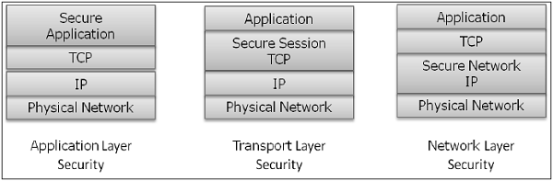
Interestingly, these protocols work at different layers of networking model.
For example,
-S/MIME protocol works at Application layer,
-SSL protocol is developed to work at transport layer, and
-IPsec protocol works at Network layer.

Slide 31
E-mail Security
Nowadays, e-mail has become very widely used network application. Let’s briefly discuss the e-mail infrastructure before proceeding to know about e-mail security protocols.
E-mail Infrastructure
The simplest way of sending an e-mail would be sending a message directly from the sender’s machine to the recipient’s machine.
In this case, it is essential for both the machines to be running on the network simultaneously. However, this setup is impractical as users may occasionally connect their machines to the network.

Slide 32
Hence, the concept of setting up e-mail servers arrived. In this setup, the mail is sent to a mail server which is permanently available on the network. When the recipient’s machine connects to the network, it reads the mail from the mail server.
In general, the e-mail infrastructure consists of a mesh of mail servers, also termed as Message Transfer Agents (MTAs) and client machines running an e-mail program comprising of User Agent (UA) and local MTA.
Typically, an e-mail message gets forwarded from its UA, goes through the mesh of MTAs and finally reaches the UA on the recipient’s machine.

Slide 33
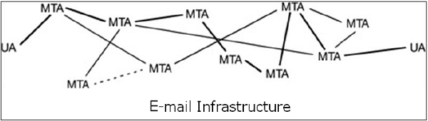
The protocols used for e-mail are as follows −
--->Simple mail Transfer Protocol (SMTP) used for forwarding e-
mail messages.
--->Post Office Protocol (POP) and Internet Message Access
Protocol (IMAP) are used to retrieve the messages
by recipient from the server.

Slide 34
E-Mail Security Services
Confidentiality − E-mail message should not be read by anyone but the intended recipient.
Authentication − E-mail recipient can be sure of the identity of the sender.
Integrity − Assurance to the recipient that the e-mail message has not been altered since it was transmitted by the sender.
Non-repudiation − E-mail recipient is able to prove to a third party that the sender really did send the message.
Proof of submission − E-mail sender gets the confirmation that the message is handed to the mail delivery system.
Proof of delivery − Sender gets a confirmation that the recipient received the message.

Slide 35
Security services such as privacy, authentication, message integrity, and non-repudiation are usually provided by using public key cryptography. Typically, there are three different scenarios of e-mail communication. We will discuss the methods of achieving above security services in these scenarios. One-to-One E-mail One-to-Multiple Recipients E-mail One-to-Distribution List E-mail

Slide 36
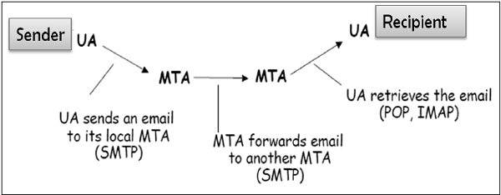
One-to-One E-mail
In this scenario, the sender sends an e-mail message to only one recipient. Usually, not more than two MTA are involved in the communication.
Let’s assume a sender wants to send a confidential e-mail to a recipient. The provision of privacy in this case is achieved as follows −
The sender and receiver have their private-public keys as (S_{PVT}, S_{PUB}) and (R_{PVT}, R_{PUB}) respectively.
The sender generates a secret symmetric key, K_{S} for encryption. Though the sender could have used R_{PUB} for encryption, a symmetric key is used to achieve faster encryption and decryption.
The sender encrypts message with key K_{S} and also encrypts K_{S} with public key of the recipient, R_{PUB}.
The sender sends encrypted message and encrypted K_{S} to the recipient.
The recipient first obtains K_{S} by decrypting encoded K_{S} using his private key, R_{PVT}.
The recipient then decrypts message using the symmetric key, K_{S}.

Slide 37
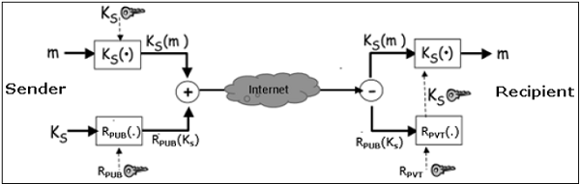
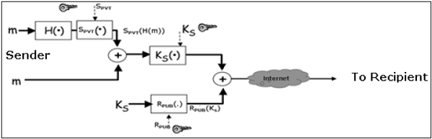
If message integrity, authentication, and non-repudiation services are also needed in this scenario, the following steps are added to the above process.
The sender produces hash of message and digitally signs this hash with his private key, S_{PVT}.
The sender sends this signed hash to the recipient along with other components.
The recipient uses public key S_{PUB} and extracts the hash received under the sender’s signature.
The recipient then hashes the decrypted message and now compares the two hash values. If they match, message integrity is considered to be achieved.
Also, the recipient is sure that the message is sent by the sender (authentication). And lastly, the sender cannot deny that he did not send the message (non-repudiation

Slide 38
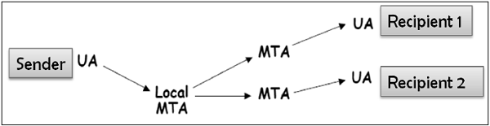
One-to-Multiple Recipients E-mail
In this scenario, the sender sends an e-mail message to two or more recipients. The list is managed by the sender’s e-mail program (UA + local MTA). All recipients get the same message.
Let’s assume, the sender wants to send confidential e-mail to many recipients (say R1, R2, and R3). The provision of privacy in this case is achieved as follows −
The sender and all recipients have their own pair of private-public keys.
The sender generates a secret symmetric key, K_{s} and encrypts the message with this key.
The sender then encrypts K_{S} multiple times with public keys of R1, R2, and R3, getting R1_{PUB}(K_{S}), R2_{PUB}(K_{S}), and R3_{PUB}(K_{S}).
The sender sends encrypted message and corresponding encrypted K_{S} to the recipient. For example, recipient 1 (R1) receives encrypted message and R1_{PUB}(K_{S}).
Each recipient first extracts key K_{S} by decrypting encoded K_{S} using his private key.
Each recipient then decrypts the message using the symmetric key, K_{S}.
For providing the message integrity, authentication, and non-repudiation, the steps to be followed are similar to the steps mentioned above in one-to-one e-mail scenario.

Slide 39
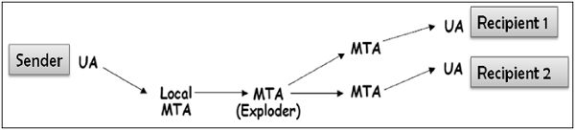
One-to-Distribution List E-mail
In this scenario, the sender sends an e-mail message to two or more recipients but the list of recipients is not managed locally by the sender. Generally, the e-mail server (MTA) maintains the mailing list.
The sender sends a mail to the MTA managing the mailing list and then the mail is exploded by MTA to all recipients in the list.

Slide 40
In this case, when the sender wants to send a confidential e-mail to the recipients of the mailing list (say R1, R2, and R3); the privacy is ensured as follows −
The sender and all recipients have their own pair of private-public keys. The Exploder Server has a pair of private-public key for each mailing list (List_{PUB}, List_{PVT}) maintained by it.
The sender generates a secret symmetric key K_{s} and then encrypts the message with this key.
The sender then encrypts K_{S} with the public key associated with the list, obtains List_{PUB}(K_{S}).
The sender sends encrypted message and List_{PUB}(K_{S}). The exploder MTA decrypts List_{PUB}(K_{S}) using List_{PVT} and obtains K_{S}.
The exploder encrypts K_{S} with as many public keys as there are members in the list.
The Exploder forwards the received encrypted message and corresponding encrypted K_{S} to all recipients in the list. For example, the Exploder forwards the encrypted message and R1_{PUB}(K_{S}) to recipient 1 and so on.

Slide 41
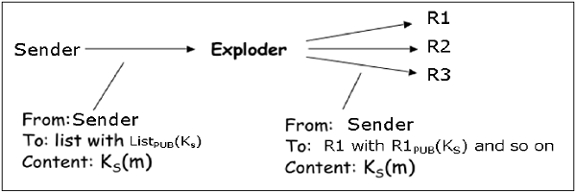
Most of the above security mechanisms for e-mail are provided by two popular schemes, Pretty Good Privacy (PGP) and S/MIME. We discuss both in the following sections.

Slide 42
S/MIME (Secure/Multipurpose Internet Mail Extensions)
S/MIME (Secure/Multipurpose Internet Mail Extensions) is a standard for securing email using public key cryptography and X.509 digital certificates.
It provides three primary security services:
Encryption – Ensures only the intended recipient can read the email.
Digital Signatures – Verifies the sender's identity and ensures the message has not been altered.
Message Integrity – Detects any tampering after the message was sent.

Slide 43
How S/MIME works
Each user has:
A private key (kept secret)
A public key (shared via a digital certificate)
The certificate is issued by a trusted Certificate Authority (CA).
Sending an encrypted email
The sender obtains the recipient's public certificate.
The email is encrypted using the recipient's public key.
Only the recipient's private key can decrypt it.

Slide 44
Sending a signed email
The sender computes a hash of the message.
The hash is encrypted with the sender's private key (creating the digital signature).
The recipient verifies the signature using the sender's public key.
Benefits
Confidentiality
Authentication
Integrity
Non-repudiation (the sender cannot easily deny sending a signed message)

Slide 45
Limitations
Requires users to obtain and manage digital certificates.
Both sender and recipient need S/MIME-compatible email clients.
Certificate distribution and renewal can be administratively challenging.
Common S/MIME-compatible email clients
Microsoft Outlook
Apple Mail
Mozilla Thunderbird
IBM Notes

Slide 46
Pretty Good Privacy (PGP)
Pretty Good Privacy (PGP) is an e-mail encryption scheme. It has become the de-facto standard for providing security services for e-mail communication.
As discussed above, it uses public key cryptography, symmetric key cryptography, hash function, and digital signature.
Services provided by PGP
Privacy
Sender Authentication
Message Integrity
Non-repudiation
Along with these security services, it also provides data compression and key management support. PGP uses existing cryptographic algorithms such as RSA, IDEA, MD5, etc., rather than inventing the new ones

Slide 47
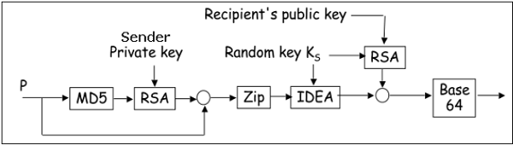
Working of PGP
--Hash of the message is calculated. (MD5 algorithm)
---Resultant 128 bit hash is signed using the private key of the sender (RSA
Algorithm).
---The digital signature is concatenated to message, and the result is
compressed.
---A 128-bit symmetric key, K_{S} is generated and used to encrypt the
compressed message with IDEA.
---K_{S} is encrypted using the public key of the recipient using RSA algorithm and
the result is appended to the encrypted message.

Slide 48
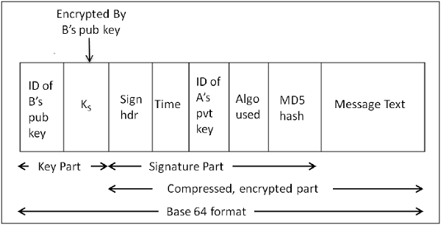
The format of PGP message is shown in the following diagram. The IDs indicate which key is used to encrypt KS and which key is to be used to verify the signature on the hash.
In PGP scheme, a message in signed and encrypted, and then MIME is encoded before transmission.

Slide 49
Components used in PGP
Public key cryptography – For key exchange and digital signatures.
Symmetric key cryptography – For fast message encryption.
Hash functions – To verify message integrity.
Compression – Reduces message size before encryption.
ASCII Armor (Radix-64 encoding) – Converts encrypted data into text format suitable for email transmission.

Slide 50
Advantages
Provides strong email and file security.
Combines fast symmetric encryption with secure public-key encryption.
Does not require a central Certificate Authority.
Supports digital signatures and encryption.
Disadvantages
Public key management can be difficult.
Initial setup is more complex than regular email.
Users must securely protect their private keys.

Slide 51
PGP | S/MIME
PGP stands for Pretty Good Privacy. | S/MIME stands for Secure/Multipurpose Internet Mail Extension.
It can be used by individuals and corporations. | It is used by corporations or for commercial purposes.
PGP is a general purpose application to protect files and used for email security. | S/MIME is used for email security.
Diffie Hellman digital signature is used. | Elgamal digital signature is used.
PGP is a data encryption and decryption computer program that offers cryptographic privacy and authentication for internet data transmission. | S/MIME provides the authentication, message integrity and non-repudiation of origin and data security services for electronic data transmission applications.
PGP was designed to eliminate security issues of text messages. | S/MIME was designed to provide security for attachments and data files.
PGP products are costlier than S/MIME. | S/MIME products are cheaper than PGP.

Slide 52
Security at the Transport layer
Network security involves securing data against attacks while it is in transit on a network.
To achieve this goal, many real-time security protocols have been designed.
For TCP/IP protocol based network, physical and data link layers are typically implemented in the user terminal and network card hardware.
TCP and IP layers are implemented in the operating system.
Anything above TCP/IP is implemented as user process.

Slide 53
Need for Transport Layer Security
Let's discuss a typical Internet-based business transaction.
Bob visits Alice’s website for trade goods. In a form on the website, Bob enters the type of good and quantity desired, his address and payment card details.
Bob clicks on Submit and waits for delivery of goods with debit of price amount from his account.
All this sounds good, but in absence of network security, Bob could be in for a few surprises.
If transactions did not use confidentiality (encryption), an attacker could obtain his payment card information. The attacker can then make purchases at Bob's expense.
If no data integrity measure is used, an attacker could modify Bob's order in terms of type or quantity of goods.

Slide 54
Transport layer security schemes can address these problems by enhancing TCP/IP based network communication with confidentiality, data integrity, server authentication, and client authentication.
The security at this layer is mostly used to secure HTTP based web transactions on a network. However, it can be employed by any application running over TCP.

Slide 55
Philosophy of TLS Design
Transport Layer Security (TLS) protocols operate above the TCP layer.
Design of these protocols use popular Application Program Interfaces (API) to TCP, called “sockets" for interfacing with TCP layer.
Applications are now interfaced to Transport Security Layer instead of TCP directly.
Transport Security Layer provides a simple API with sockets, which is similar and analogous to TCP's API.

Slide 56
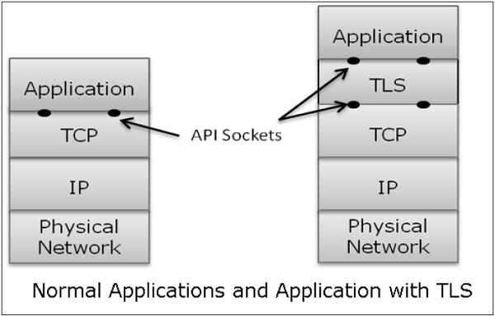
In the above diagram, although TLS technically resides between application and transport layer, from the common perspective it is a transport protocol that acts as TCP layer enhanced with security services.
TLS is designed to operate over TCP, the reliable layer 4 protocol (not on UDP protocol), to make design of TLS much simpler, because it doesn't have to worry about ‘timing out’ and ‘retransmitting lost data’. The TCP layer continues doing that as usual which serves the need of TLS.

Slide 57
Why TLS is Popular?
The reason for popularity of using a security at Transport Layer is simplicity.
Design and deployment of security at this layer does not require any change in TCP/IP protocols that are implemented in an operating system.
Only user processes and applications needs to be designed/modified which is less complex.

Slide 58
Secure Socket Layer (SSL)
Secure Socket Layer (SSL) provides security to the data that is transferred between web browser and server.
SSL encrypts the link between a web server and a browser which ensures that all data passed between them remain private and free from attack.

Slide 59
Salient Features of SSL
The salient features of SSL protocol are as follows −
SSL provides network connection security through −
Confidentiality − Information is exchanged in an encrypted form.
Authentication − Communication entities identify each other through the use of digital certificates. Web-server authentication is mandatory whereas client authentication is kept optional.
Reliability − Maintains message integrity checks.

Slide 60
SSL is available for all TCP applications.
Supported by almost all web browsers.
Provides ease in doing business with new online entities.
Developed for Web e-commerce

Slide 61
Architecture of SSL
SSL protocol is designed to interwork between application and transport layer as shown in the following image −

Slide 62
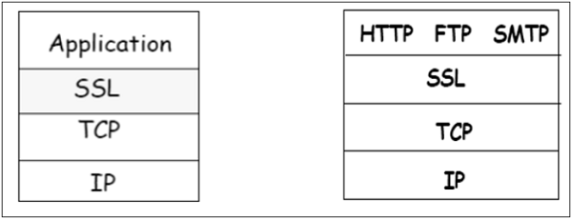
SSL itself is not a single layer protocol as depicted in the image; in fact it is composed of two sub-layers.
Lower sub-layer comprises of the one component of SSL protocol called as SSL Record Protocol. This component provides integrity and confidentiality services.
Upper sub-layer comprises of three SSL-related protocol components and an application protocol. Application component provides the information transfer service between client/server interactions. Technically, it can operate on top of SSL layer as well. Three SSL related protocol components are −
SSL Handshake Protocol
Change Cipher Spec Protocol
Alert Protocol.
These three protocols manage all of SSL message exchanges

Slide 63
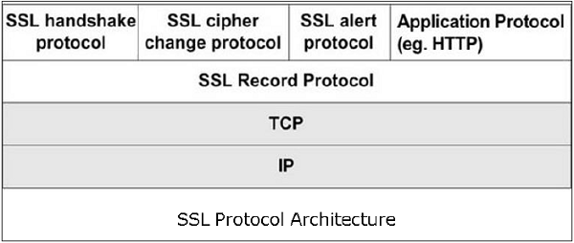

Slide 64
Functions of SSL Protocol Components
The four sub-components of the SSL protocol handle various tasks for secure communication between the client machine and the server.
Record Protocol
The record layer formats the upper layer protocol messages.
It fragments the data into manageable blocks (max length 16 KB). It optionally compresses the data.
Encrypts the data.
Provides a header for each message and a hash (Message Authentication Code (MAC)) at the end.
Hands over the formatted blocks to TCP layer for transmission.

Slide 65
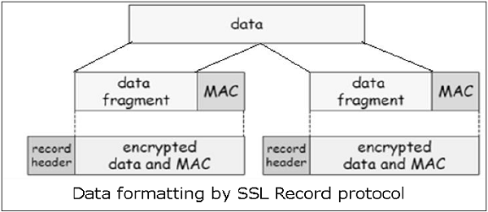
SSL Handshake Protocol
It is the most complex part of SSL. It is invoked before any application data is transmitted.
It creates SSL sessions between the client and the server.
Establishment of session involves Server authentication, Key and algorithm negotiation, Establishing keys and Client authentication (optional).
A session is identified by unique set of cryptographic security parameters.
Multiple secure TCP connections between a client and a server can share the same session.
Handshake protocol actions through four phases.

Slide 66
ChangeCipherSpec Protocol
Simplest part of SSL protocol. It comprises of a single message exchanged between two communicating entities, the client and the server.
As each entity sends the ChangeCipherSpec message, it changes its side of the connection into the secure state as agreed upon.
The cipher parameters pending state is copied into the current state.
Exchange of this Message indicates all future data exchanges are encrypted and integrity is protected.
SSL Alert Protocol
This protocol is used to report errors – such as unexpected message, bad record MAC, security parameters negotiation failed, etc.
It is also used for other purposes – such as notify closure of the TCP connection, notify receipt of bad or unknown certificate, etc

Slide 67
Security in Network Layer
The popular framework developed for ensuring security at network layer is Internet Protocol Security (IPsec).
Features of Ipsec
IPsec is not designed to work only with TCP as a transport protocol. It works with UDP as well as any other protocol above IP such as ICMP, OSPF etc.
IPsec protects the entire packet presented to IP layer including higher layer headers.
Since higher layer headers are hidden which carry port number, traffic analysis is more difficult.
IPsec works from one network entity to another network entity.
Tough widely used to provide secure communication between network entities, IPsec can provide host-to-host security as well.
The most common use of IPsec is to provide a Virtual Private Network (VPN), either between two locations (gateway-to-gateway) or between a remote user and an enterprise network (host-to-gateway).

Slide 68
Security Functions
The important security functions provided by the IPsec are as follows −
Confidentiality
Enables communicating nodes to encrypt messages.
Prevents eavesdropping by third parties.
Origin authentication and data integrity.
Provides assurance that a received packet was actually transmitted by the party identified as the source in the packet header.
Confirms that the packet has not been altered
Key management.
Allows secure exchange of keys.
Protection against certain types of security attacks, such as replay attacks.

Slide 69
Operations Within IPsec
The IPsec suite can be considered to have two separate operations providing a complete set of security services.
These two operations are IPsec Communication and Internet Key Exchange.

Slide 70
IPsec Communication
It is typically associated with standard IPsec functionality. It involves encapsulation, encryption, and hashing the IP datagrams and handling all packet processes.
Internet Key Exchange.
IKE is responsible for creation of keys for IPsec and providing authentication during key establishment process.

Slide 71
IPsec Communication Modes
IPsec Communication has two modes of functioning
Transport mode
Transport mode encrypts only the payload (records) of the authentic IP packet, leaving the IP header intact. Its used for end-to-end communication between hosts.
Tunnel mode.
In tunnel mode, the complete original IP packet which includes the header and payload is encrypted and inserted into the brand-new IP packet. This mode is normally used for network-to-network connections.

Slide 72
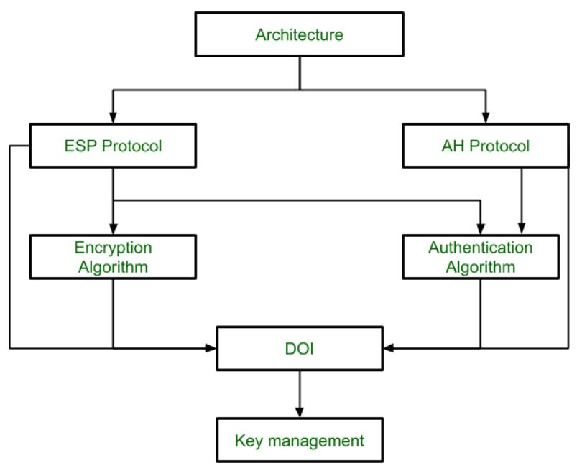
IPSec Architecture

Slide 73
IPsec Protocols
IPsec uses the security protocols to provide desired security services.
Security associations between the communicating entities are established and maintained by the security protocol used.
There are two security protocols defined by IPsec — Authentication Header (AH) and Encapsulating Security Payload (ESP).

Slide 74
Authentication Header
The AH protocol provides service of data integrity and origin authentication. It optionally provides for message replay resistance. However, it does not provide any form of confidentiality.
Encapsulation Security Protocol (ESP)
ESP provides security services such as confidentiality, integrity, origin authentication, and optional replay resistance. The set of services provided depends on options selected at the time of Security Association (SA) establishment.

Slide 75
Open source/Free/ Trial Tools: Implementation of Cryptographic Techniques -OpenSSL
OpenSSL is an open source tool for using the Secure Socket Layer (SSL) and Transport Layer Security (TLS) protocols for Web authentication
OpenSSL offers cryptographic functions to support SSL/TLS protocols.
In SSL security, websites use digital certificates to prove their legitimacy.
OpenSSL is written in the C programming language and depend on different ciphers and algorithms to provide encryption.

Slide 76
OpenSSL is split into four principal components
libcrypto.
This is the core library for providing implementations of numerous cryptographic primitives. In addition it provides a set of supporting services which are used by libssl .
Libssl
This library depends on libcrypto and implements the TLS and DTLS protocols.
Engine. The functionality of libcrypto can be extended through the Engine API.
Typically engines are dynamically loadable modules that are registered with libcrypto to provide cryptographic algorithm implementation
Applications
The applications are a set of command line tools that use the underlying libssl and libcrypto components to provide a set of cryptographic and other features such as
a) Key and parameter generation and inspection
b)Certificate generation and inspection
c)SSL/TLS test tools
d)ASN.1 inspection

Slide 77
OpenSSL characteristics
EVP. The EVP (envelope) API level provides the high-level abstract interface to cryptographic functionality separate from the concrete implementation binding.
Direct use of concrete cryptographic algorithm implementations via interfaces
The EVP layer also provides composite operations, such as signing and verifying. Certain composite operations are also provided as an EVP-level operation (such as HMAC-SHA256).
EVP also allow use of cryptographic algorithms in an algorithm-agnostic manner

Slide 78
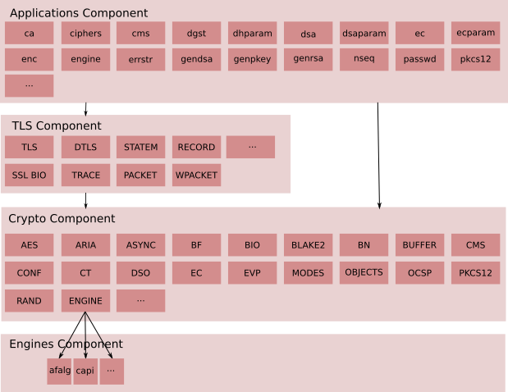
Conceptual Component View

Slide 79
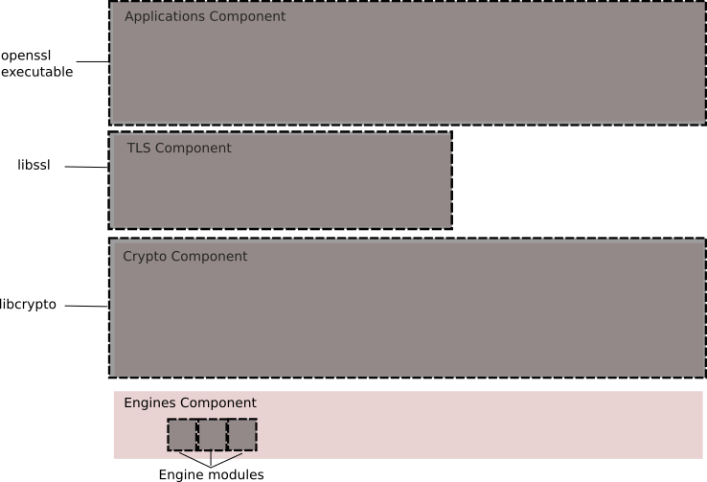
Packaging View The components described above are packaged into libraries (libcrypto and libssl) and associated engine interfaces as well as an “openssl” command line executable for running the various applications. This is illustrated in the diagram below.

Slide 80
Applications: Command line applications, e.g. ca, ciphers, cms, dgst etc
Protocols: Provides capabilities for communicating between endpoints according to standard protocols
TLS Protocols: An implementation of all supported TLS/DTLS protocols and supporting infrastructure such as:
SSL BIO: A BIO for communication using TLS
Statem: The TLS state machine
Record: The TLS record layer
Other Protocols
CMS: An implementation of the Cryptographic Message Syntax standard
OCSP: An implementation of Online Certificate Status Protocol
TS: An implementation of the Timestamp Protocol
Supporting Services: Components specifically designed to support the implementation of protocol code
Packet: Internal component for reading protocol messages
Wpacket: Internal component for writing protocol messages

Slide 81
Hash values
Hash values can be thought of as fingerprints for files.
The contents of a file are processed through a cryptographic algorithm, and a unique numerical value – the hash value - is produced that identifies the contents of the file.
A hash value is a numeric value of a fixed length that uniquely identifies data.
Hash values represent large amounts of data as much smaller numeric values, so they are used with digital signatures.
You can sign a hash value more efficiently than signing the larger value.
If the contents are modified in any way, the value of the hash will also change significantly.
Two algorithms are currently widely used to produce hash values: MD5 and SHA1 algorithms.

Slide 82
Hashing is an algorithm performed on data such as a file or message to produce a number called a hash (sometimes called a checksum).
The hash is used to verify that data is not modified, tampered with, or corrupted.
In other words, you can verify the data has maintained integrity.
Hashing is the process of transforming any given key or a string of characters into another value.
This is usually represented by a shorter, fixed-length value or key that represents and makes it easier to find or employ the original string
A key point about a hash is that no matter how many times you execute the hashing algorithm against the data, the hash will always be the same if the data is the same
The most popular use for hashing is the implementation of hash tables

Slide 83
Hashing Algorithms
MD5
Message Digest 5 (MD5) is a common hashing algorithm that produces a 128-bithash.
Hashes are commonly shown in hexadecimal format instead of a stream of 1s and 0s.
---> For example, an MD5 hash is displayed as 32 hexadecimal characters instead of 128 bits.
MD5 was developed as an improvement of MD4, with advanced security purposes. The output of MD5 (Digest size) is always 128 bits.
MD5 was developed in 1991 by Ronald Rivest

Slide 84
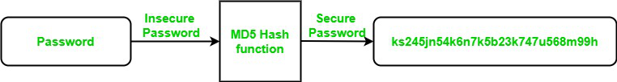
Use Of MD5 Algorithm
It is used for file authentication.
In a web application, it is used for security purposes. e.g. Secure password of users etc.
Using this algorithm, We can store our password in 128 bits format.

Slide 85
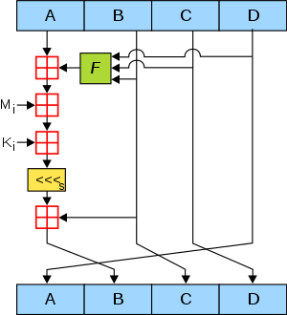

Slide 86
Working of the MD5 Algorithm
MD5 algorithm follows the following steps
1. Append Padding Bits: In the first step, we add padding bits in the original message in such a way that the total length of the message is 64 bits less than the exact multiple of 512.
Suppose we are given a message of 1000 bits. Now we have to add padding bits to the original message. Here we will add 472 padding bits to the original message. After adding the padding bits the size of the original message/output of the first step will be 1472 i.e. 64 bits less than an exact multiple of 512 (i.e. 512*3 = 1536). Length(original message + padding bits) = 512 * i – 64 where i = 1,2,3 . . .

Slide 87
2. Append Length Bits: In this step, we add the length bit in the output of the first step in such a way that the total number of the bits is the perfect multiple of 512. Simply, here we add the 64-bit as a length bit in the output of the first step. i.e. output of first step = 512 * n – 64 length bits = 64. After adding both we will get 512 * n i.e. the exact multiple of 512.
3. Initialize MD buffer: Here, we use the 4 buffers i.e. A, B, C, and D. The size of each buffer is 32 bits.
- A = 0x67425301
- B = 0xEDFCBA45
- C = 0x98CBADFE
- D = 0x13DCE476

Slide 88
4. Process Each 512-bit Block:
This is the most important step of the MD5 algorithm. Here, a total of 64 operations are performed in 4 rounds.
In the 1st round, 16 operations will be performed, 2nd round 16 operations will be performed, 3rd round 16 operations will be performed, and in the 4th round, 16 operations will be performed.
We apply a different function on each round i.e. for the 1st round we apply the F function, for the 2nd G function, 3rd for the H function, and 4th for the I function. We perform OR, AND, XOR, and NOT (basically these are logic gates) for calculating functions. We use 3 buffers for each function i.e. B, C, D.
- F(B,C,D) = (B AND C) OR (NOT B AND D)
- G(B,C,D) = (B AND C) OR (C AND NOT D)
- H(B,C,D) = B XOR C XOR D
- I(B,C,D) = C XOR (B OR NOT D )
After applying the function now we perform an operation on each block.
For performing operations we need
add modulo 2³²
M[i] – 32 bit message.
K[i] – 32 bit constant.
<<<n – Left shift by n bits.

Slide 89
Application Of MD5 Algorithm:
We use message digest to verify the integrity of files/ authenticates files.
MD5 was used for data security and encryption.
It is used to Digest the message of any size and also used for Password verification.
MD5 is faster and simple to understand.
MD5 algorithm generates a strong password in 16 bytes format. All developers like web developers use the MD5 algorithm to secure the password of users.
To integrate the MD5 algorithm, relatively low memory is necessary.
It is very easy and faster to generate a digest message of the original message.
Disadvantages of MD5 Algorithm:
MD5 generates the same hash function for different inputs.
MD5 provides poor security over SHA1.
MD5 has been considered an insecure algorithm. So now we are using SHA256 instead of MD5
MD5 is neither a symmetric nor asymmetric algorithm.

Slide 90
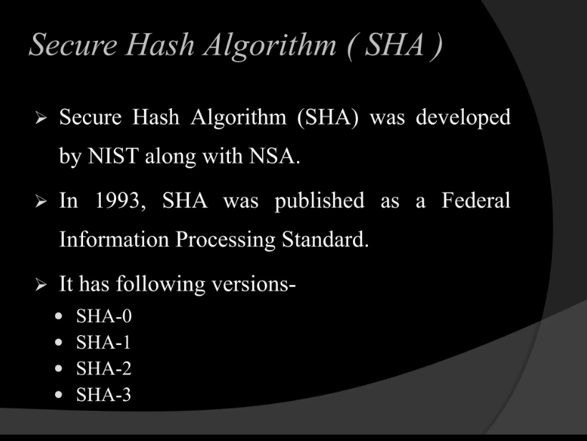

Slide 91
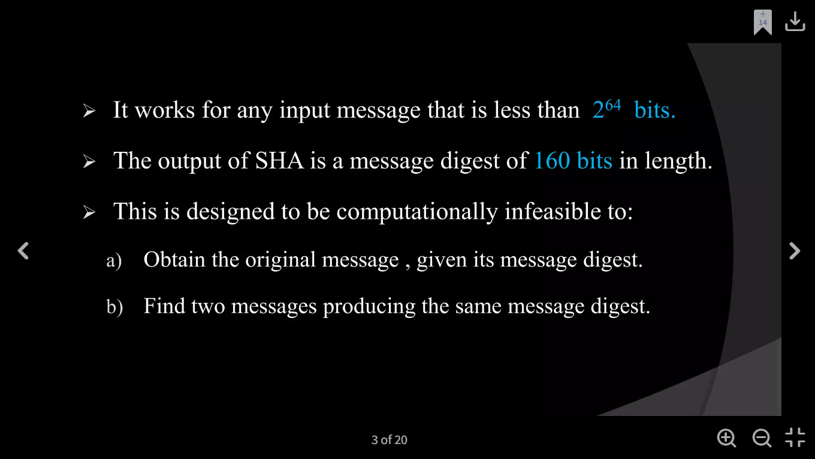

Slide 92
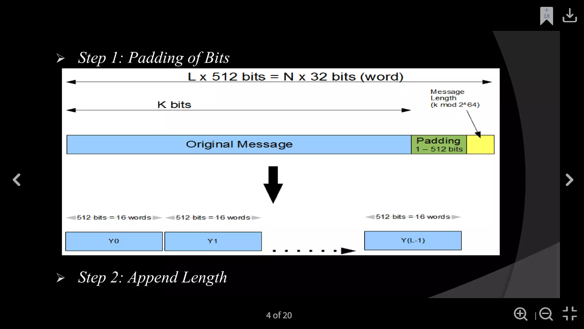

Slide 93
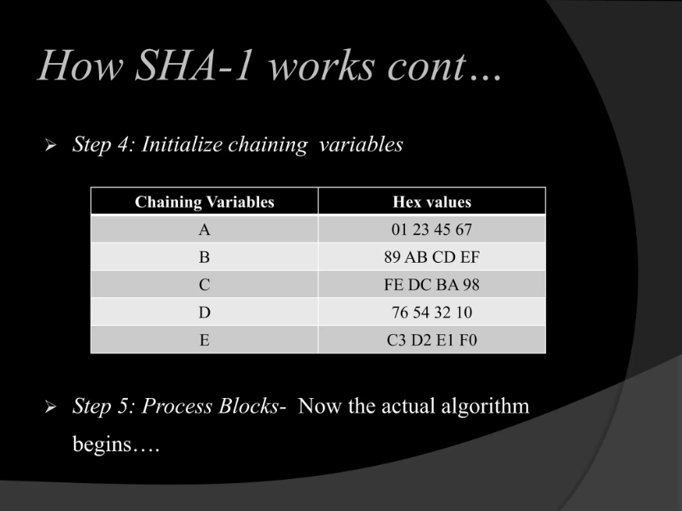

Slide 94
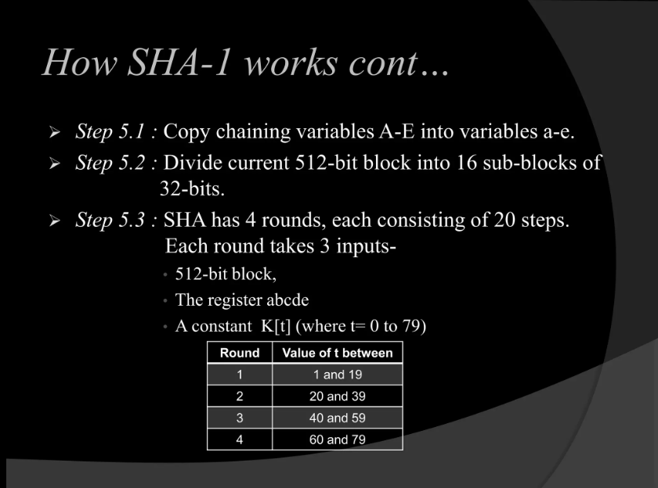

Slide 95
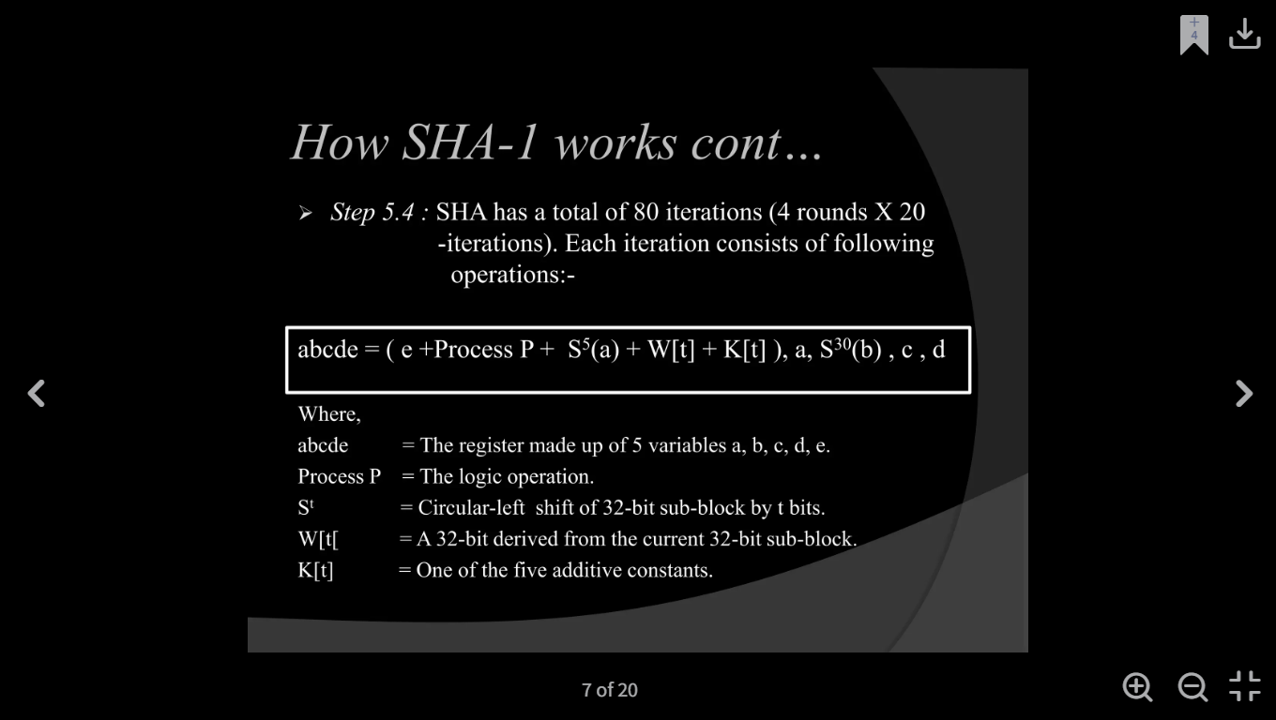

Slide 96
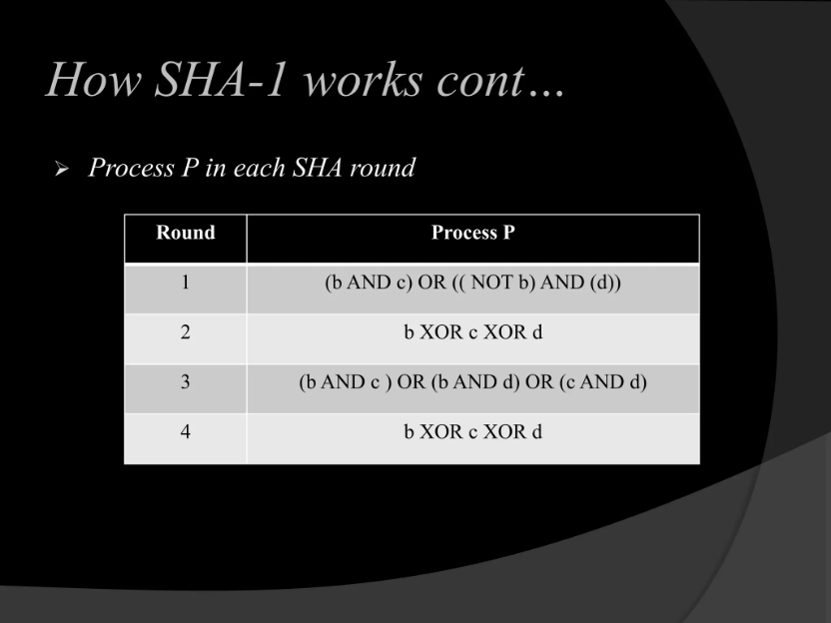

Slide 97
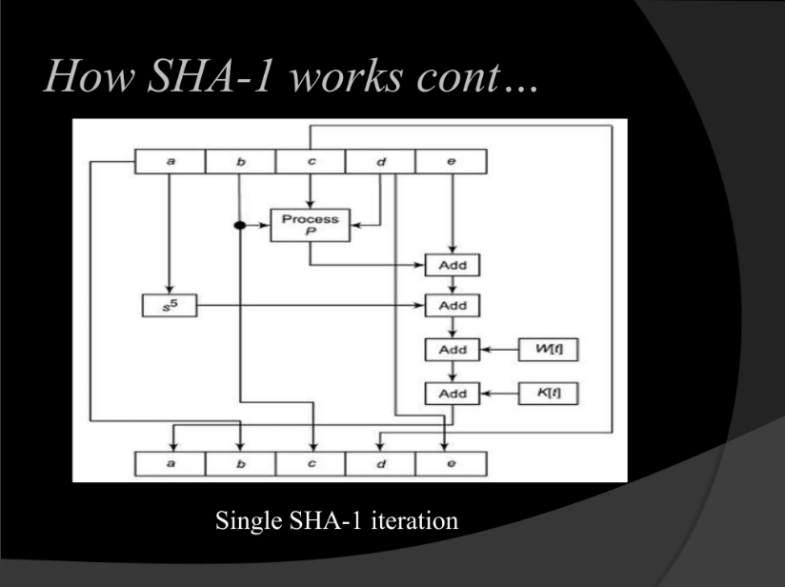

Slide 98
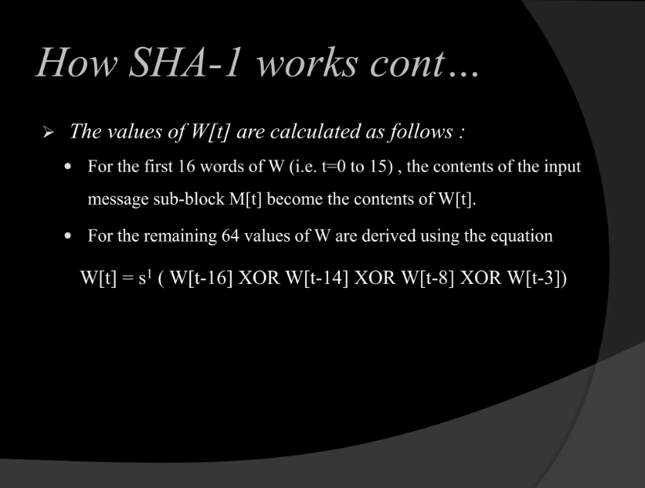

Slide 99
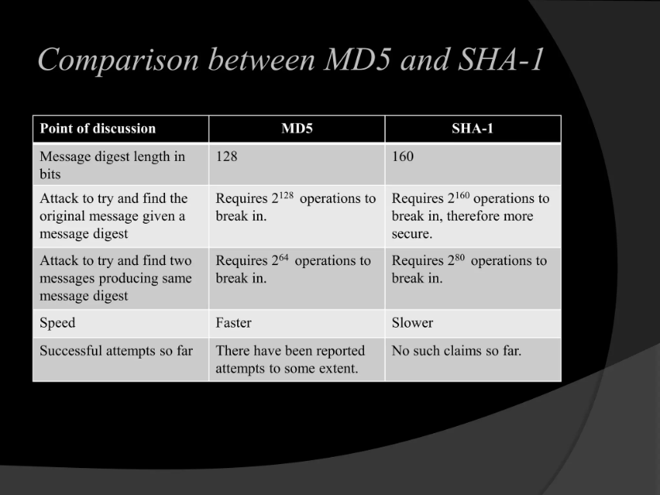

Slide 100
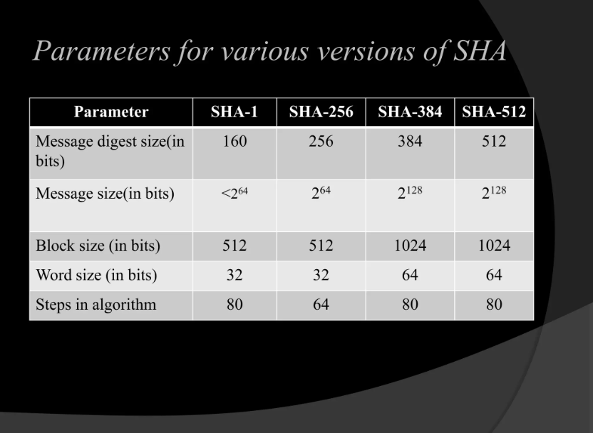

Slide 101
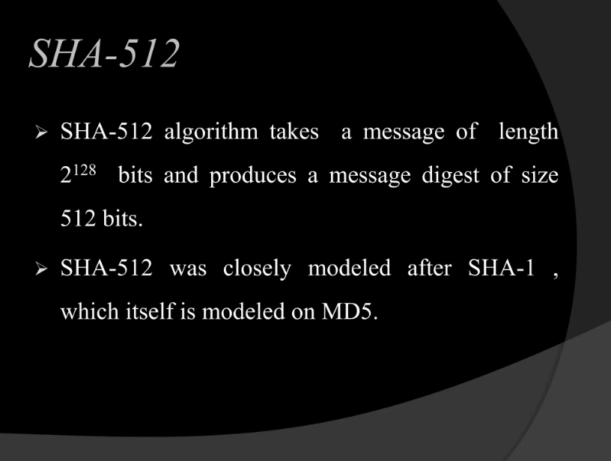

Slide 102
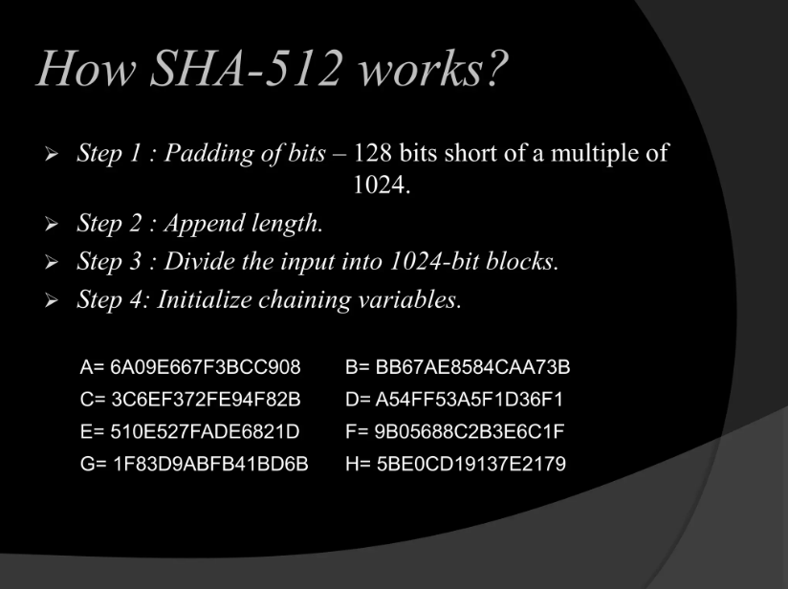

Slide 103
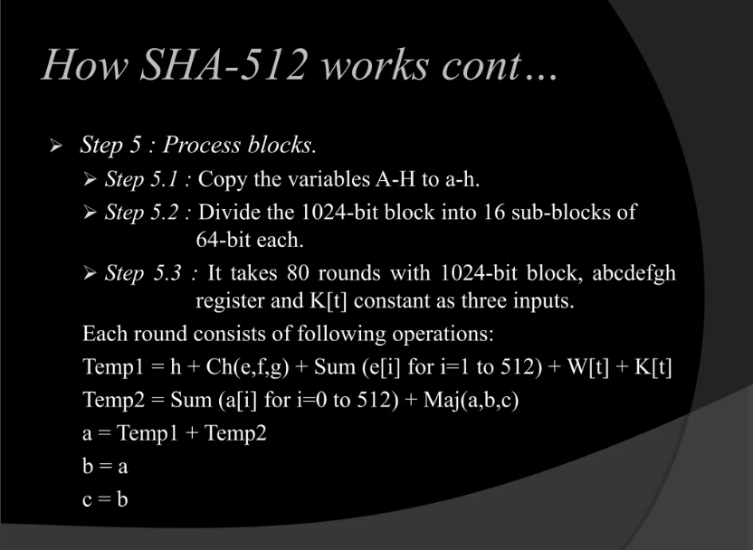

Slide 104
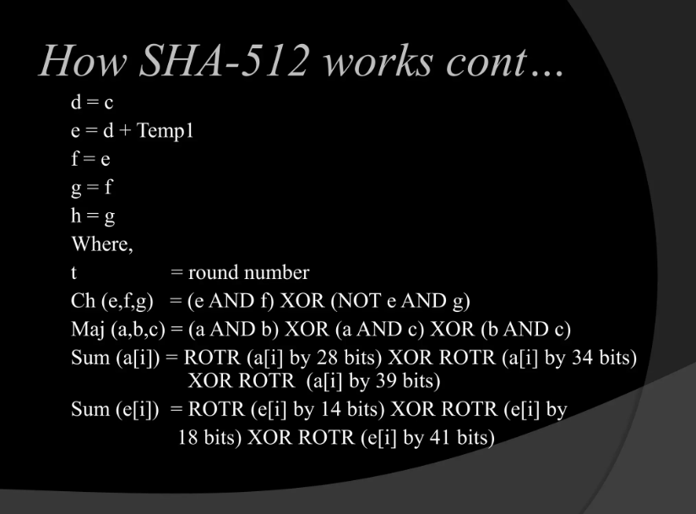

Slide 105
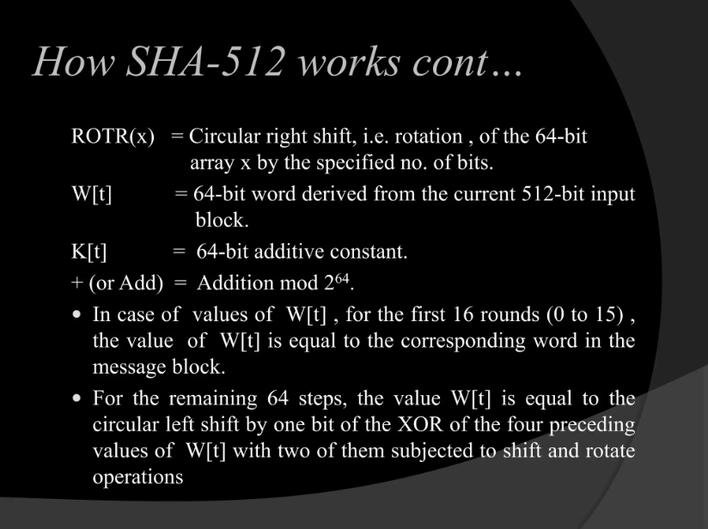

Slide 106
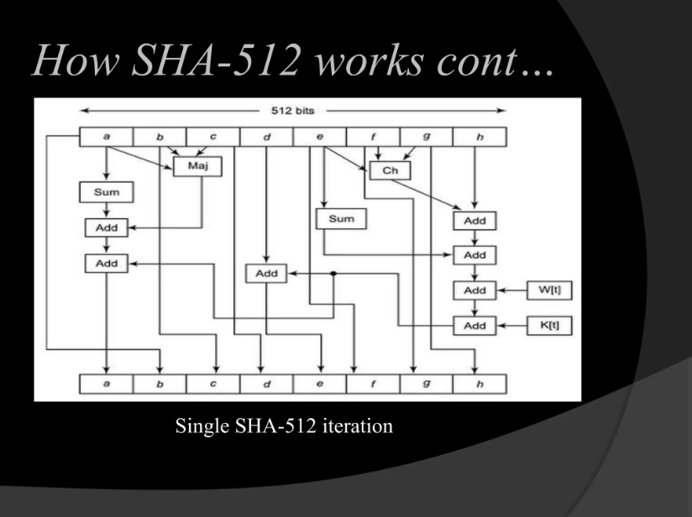

Slide 107
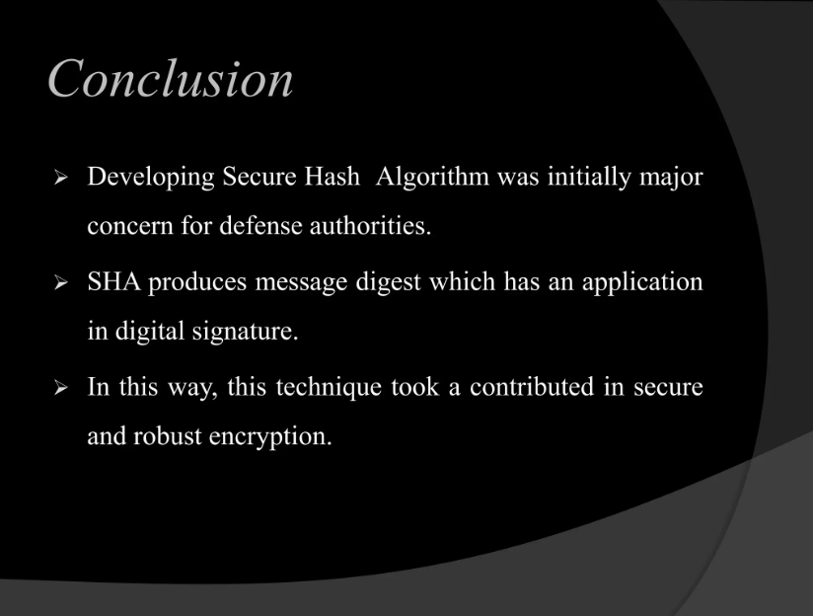

Slide 108
Steganography
Steganography is a method of hiding secret data, by embedding it into an audio, video, image, or text file. It is one of the methods working to protect secret or sensitive data from malicious attacks.
Cryptography and steganography are both methods used to hide or protect secret data. However, they differ in the respect that cryptography makes the data unreadable, or hides the meaning of the data, while steganography hides the existence of the data.
Image Steganography –
Image Steganography refers to the process of hiding data within an image file. The image selected for this purpose is called the cover image and the image obtained after steganography is called the stego image.

Slide 109
How is it done?
An image is represented as an N*M (in case of grayscale images) or N*M*3 (in case of color images) matrix in memory, with each entry representing the intensity value of a pixel.
In image steganography, a message is embedded into an image by altering the values of some pixels, which are chosen by an encryption algorithm.
The recipient of the image must be aware of the same algorithm in order to know which pixels he or she must select to extract the message

Slide 110
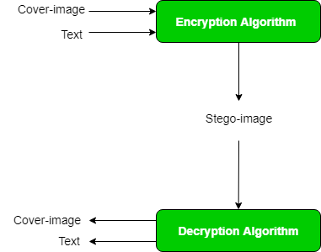

Slide 111
steganography approach involves cover a huge amount of data (picture, audio, and text) within a colour bitmap (bmp) image.
The image will be filtered and segmented with bits replacement applied to the appropriate pixels. These pixels are chosen at random rather than in order.
Detection of the message within the cover image is done by the process of steganalysis.
This can be done through comparison with the cover image, histogram plotting, or noise detection.
Efforts are being invested in developing new algorithms with a greater degree of immunity against such attacks,
Efforts are also being dedicated towards improving existing algorithms for steganalysis, to detect the exchange of secret information between terrorists or criminal

Slide 112
Course Outcomes (COs)
Upon completion of course the students will be able to
Apply cryptographic techniques and digital signature protocols

